Slide 1
Welcome Back!

Slide 2
Priorities for
2017

Slide 3
Growing & Re-energizing
Membership

Slide 5
Advocacy & Lobby

Slide 6
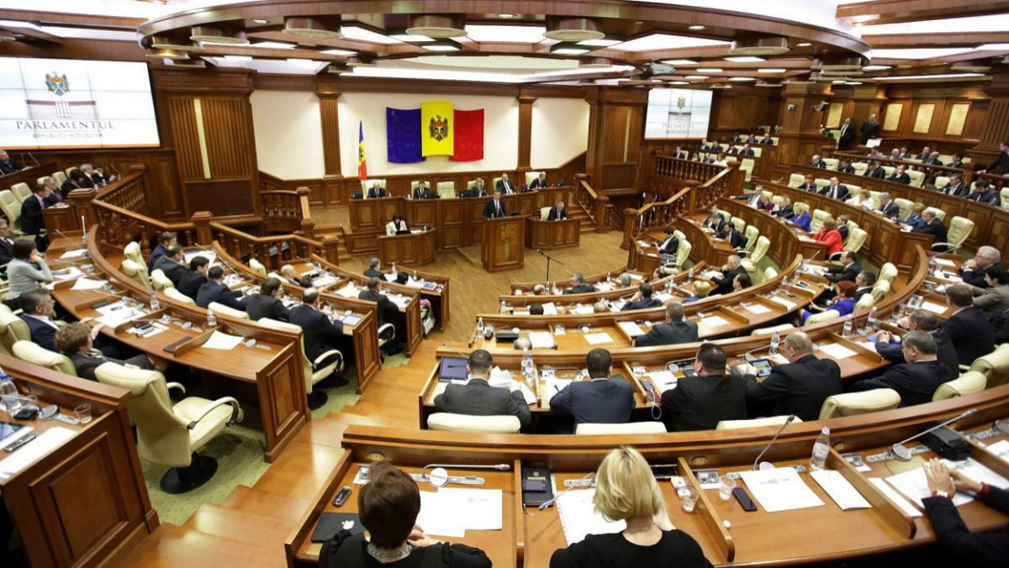
Connecting Better with Parliament

Slide 7
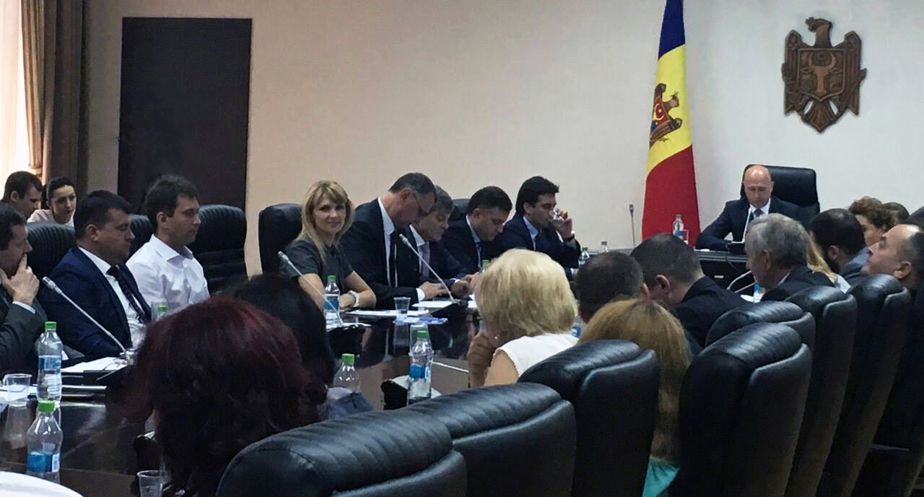
Economic Council under the Prime Minister

Slide 8
Committees

Slide 9
Tax & Legal Committee

Slide 10
Taxes
Personal Data Protection
Internal Trade
Competition Legislation

Slide 11
HR Committee

Slide 12
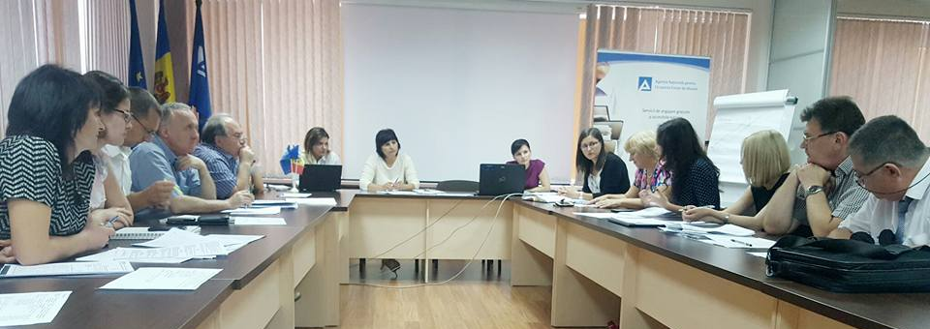
Working Group on Labor Code Amendment

Slide 13
Healthcare Committee

Slide 14
New Law on Medicines
Regulation of Drugs Prices
Copayment in the Public Health Insurance System

Slide 15
Trade & Manufacturing Committee

Slide 16
Customs
Food Safety
Environmental Legislation
Conformity Assesment and Consumer Protection

Slide 17
Financial Services Committee

Slide 18
Anti-money Laundering Law
New Banking Law
New Law on Financial Institutions

Slide 19
Free Economic Zones Committee
New Committees
Infrastructure Committee

Slide 20
Launching of AmCham Court of Commercial Arbitration

Slide 21
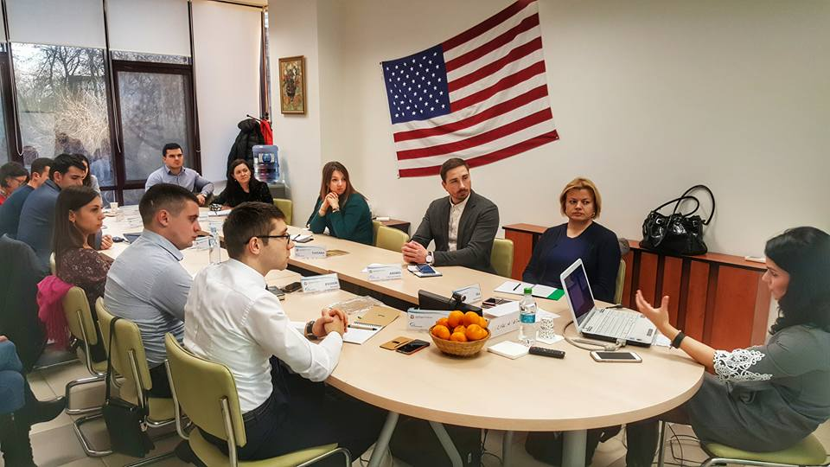
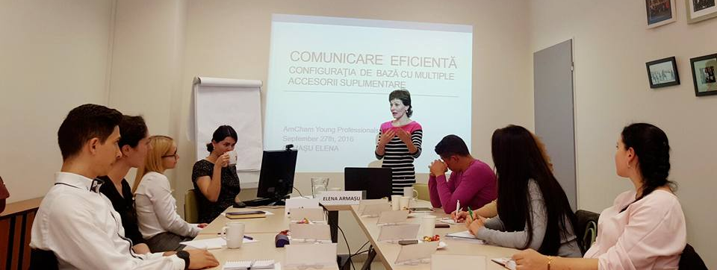
Young Professionals Program

Slide 22
Events

Slide 23
Committee Meetings
Business Breakfasts
Networking Events
Annual General Meeting

Slide 24
AmCham Services

Slide 25
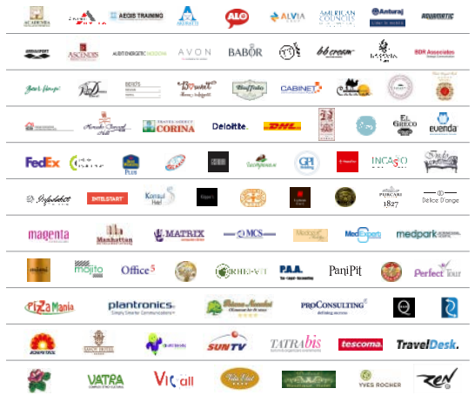
95
Attractive Offers via MDP

Slide 26
21 Visa Issued in 2016
Visa Facilitation Program

Slide 27
Job Center
The Most Accesed Section

Slide 28
Members News
Gain Exposure for Your Company

Slide 29
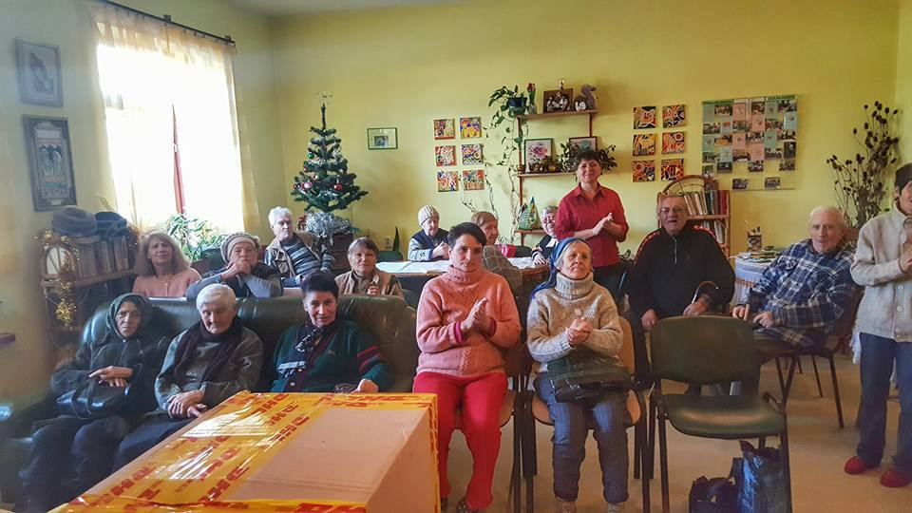
Volunteer and Donate through our CSR Projects

Slide 30
Stay Connected

Slide 31
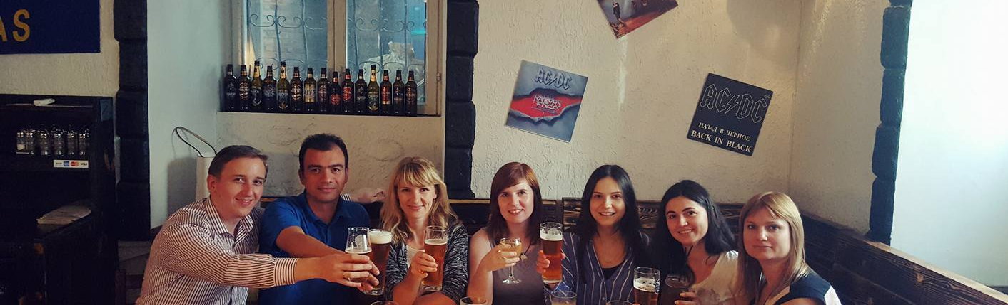
We Stay at your Disposal

